Slide 1

Interviewing Skills

Slide 2
Types of Interviews
There are several different types of interview styles you can use to screen candidates, such as:
In-person interviews: In-person interviews are held at the worksite, with both the interviewee and interviewer present.
Virtual interviews: These interviews are conducted completely online.
Phone interviews: Employers often use these interviews to prescreen candidates before scheduling an in-person interview.
One-on-one interviews: One-on-one interviews involve just one interviewer and one interviewee.
Panel/Committee interviews: A group of interviewers, such as the hiring manager, supervisor and a member of HR, interview a single candidate.
Multiple interviews: Typically, employers continue to narrow down the candidate selection pool after each round of interviews.

Slide 3
What makes a good search committee?
Effective committees don't just happen. They are carefully planned and constructed to have a balanced representation of members, a clearly defined mission or objective and work plan, a dedicated chair, and competent staffing.
The composition of a search committee is key to a broad and inclusive search and the committee should: Include individuals with different backgrounds, perspectives, and expertise. Include stakeholders with direct or indirect knowledge of the position and the technical expertise to effectively evaluate candidates' qualifications.
What's the right size for a Search Committee? The ideal Search Committee is comprised of either 5 or 7 members. The larger the Committee, the more difficult it will be to organize meetings, conduct candidate interviews and hold discussions.

Slide 4
Prepare Your Interview Questions in Advance
Plan a list of interview questions to ask a candidate based on the job requirements and their resume.
Carefully reviewing the candidate’s resume will help you formulate the right questions, guide the conversation and gain better insight into how well the candidate’s skills and experience match the job duties. Take notes during the interview.
Encourage conversation by asking the candidate to explain and elaborate on the bullet points in their resume. You can also ask them to clarify any employment gaps, job hopping or unusual job titles.
Sample Interview Questions:
Why do you feel you’d be a good candidate for this position?
Tell me more about your current position and your responsibilities.
How would your current co-workers describe your workplace performance?
Why did you apply for this position?
What are your greatest strengths/weaknesses?
The number of interview questions you should prepare depends on your candidates’ stage in the interview process. Initial phone screens, for example, are often 20-30 minutes long, so it’s a good idea to prepare 5-10 questions. For longer in-person or video interviews, come up with 10-15 open-ended interview questions and expect to ask six or seven within an hour.

Slide 5
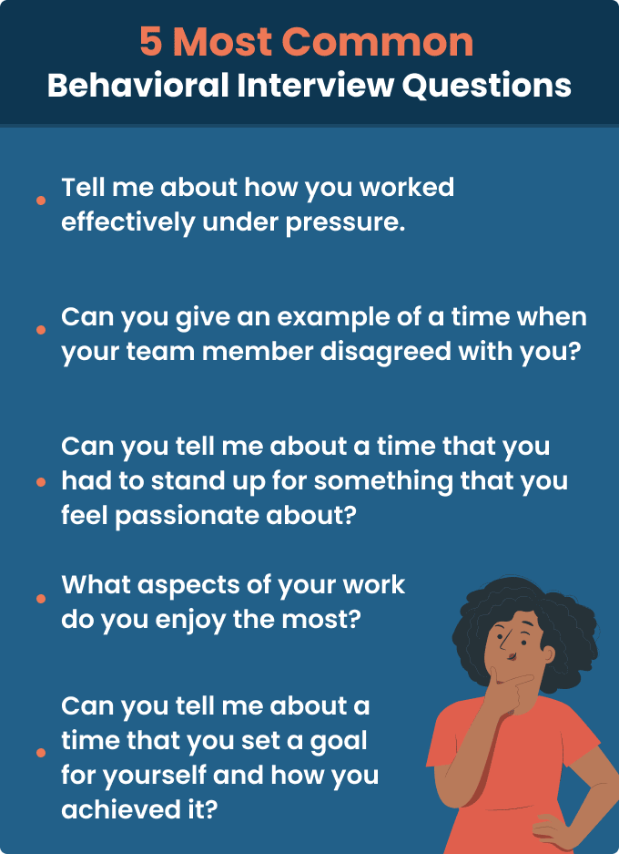
Be sure to include open-ended behavioral interview questions so candidates can elaborate on their skills and experience and display their ability to tackle challenging topics. These types of questions will also help you assess a candidate’s critical thinking and communication skills.
Sample of behavioral interview questions include:
Tell me about a specific challenge you have faced and how you overcame it.
Describe the steps you take when making workplace decisions.
How do you deal with criticism?
Tell me about a time you disagreed with a co-worker over a project and how you handled it.
Do you work well under pressure? Give examples.
How do you prioritize your workload? Give examples.

Slide 6
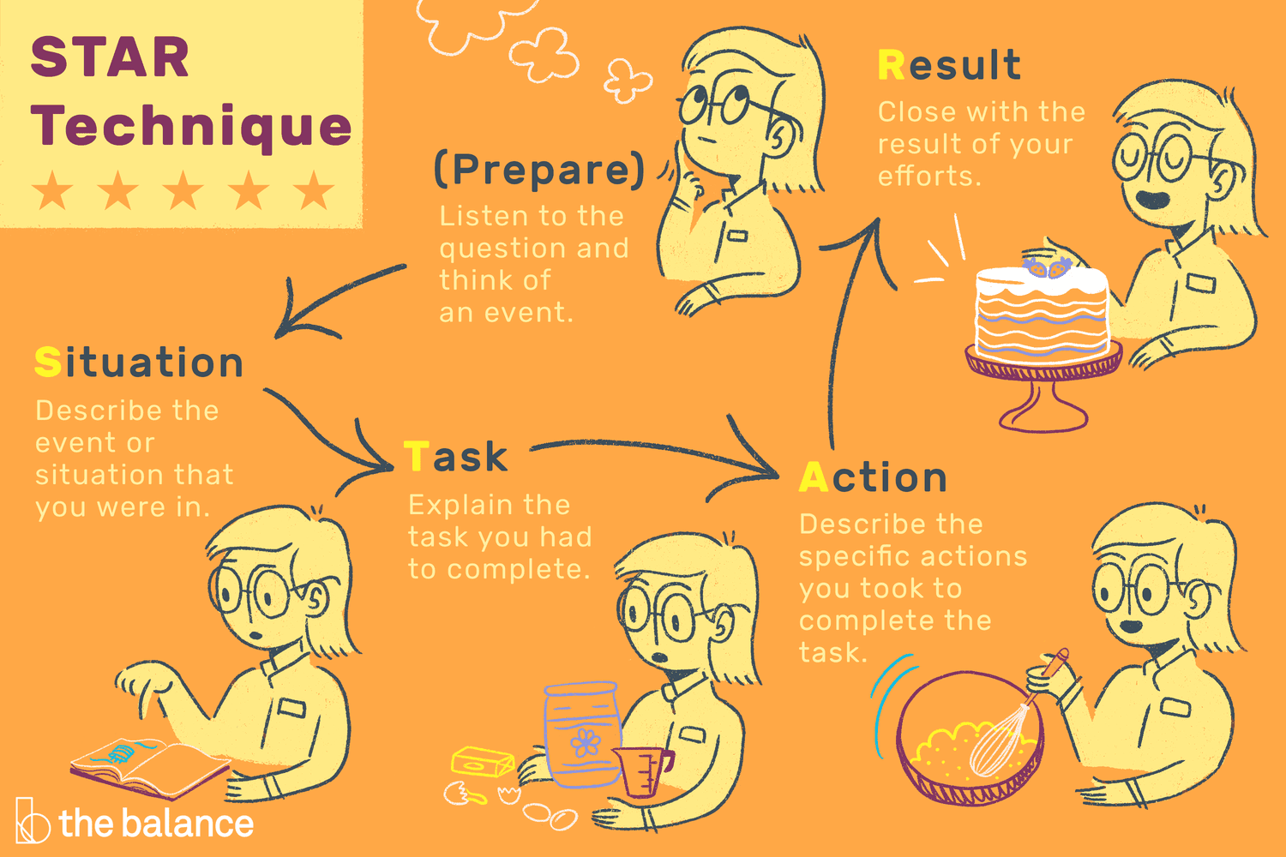
What is the STAR format interview?
The STAR method is a structured interview technique that helps you understand a candidate’s work style by following a sequential order of questions based on the acronym STAR.
Answers to STAR method interview questions follow this format:
Situation: The candidate describes the scene and provides relevant details of their example. Look for an answer that explains the context of the situation and why it connects to your question.
Task: Next, the candidate describes their role in the situation. This can help you determine what level of responsibility they had in their previous roles.
Action: They explain how they addressed the situation and what steps they took to overcome the challenge. A good answer shows how the candidate added value to the situation and made logical decisions.
Result: At the end of their answer, the candidate explains the outcome of the situation. A quality answer includes concrete examples and quantifiable achievements. They should explain the direct effects of their efforts in their answer.

Slide 7
What shouldn't I ask when hiring?
You should avoid asking applicants about personal characteristics that are protected by law, such as race, color, religion, sex, national origin or age. These types of questions may discourage some individuals from applying, may be viewed suspiciously by some applicants, and may be considered evidence of intent to discriminate by the EEOC. If you do not have this information when you decide who to hire, it may be easier for you to defend your business against a hiring discrimination complaint.
For example, you should avoid:
Questions about race, religion or ethnicity, such as:
  Are you biracial?
  Which church do you attend?
  What language(s) do you speak at home?
Questions about age, unless used to verify that applicants meet any age-related legal requirements for the job.
Questions about an applicant's pregnancy or plans to start a family, such as:
  Are you pregnant?
  Do you plan to have children within the next year?
Questions about an applicant’s disability or are likely to reveal whether a candidate has a disability, such as:
Do you have a disability?
What medications are you currently taking?
Have you filed any workers' compensation claims?

Slide 8

The college is required by statute to give “preference” to veterans in employment in all Career Service positions in the Florida College System. The preference standard is met if veterans who meet the minimum qualifications for the position are interviewed. Preference do not require the employment of a veteran over a better-qualified applicant.
What Character of Discharge must be on the DD Form 214 in order to qualify for Veterans’ Preference?
A Veteran MUST have been discharged with nothing less than an “HONORABLE” discharge.

Slide 9
Who qualifies for Veterans’ Preference?
Individuals eligible for Veterans’ Preference (VP) are as follows:
1. Disabled Veterans who have served on active duty in any branch of the Armed Forces and who presently have an existing service-connected disability that is compensable under public laws administered by the Department of Veterans’ Affairs (DVA), or are receiving compensation, disability retirement benefits, or pension by reason of public laws administered by the DVA and the Department of Defense (DoD).
2. The spouse of a Veteran:
a) Who has a total and permanent service-connected disability and who, because of this disability, cannot qualify for employment; or
b) Who is missing in action, captured in line of duty by a hostile force, or detained or interned in line of duty by a foreign government or power.
3. A Veteran of any war, who has served at least one day during that wartime period as defined in section 1.01(14), F.S., or who has been awarded a campaign or expeditionary medal. Active duty for training shall not be allowed for eligibility under this paragraph.
4. The un-remarried widow or widower of a Veteran who died of a service-connected disability.
5. The mother, father, legal guardian, or un-remarried widow or widower of a service member who died as a result of military service under combat-related conditions as verified by the DoD. 2
6. A Veteran as defined in section 1.01(14), F.S. The term “Veteran” is defined as a person who served in the active military, naval, or air service and who was discharged or released therefrom under honorable conditions only or who later received an upgraded discharge under honorable conditions. “Active Duty for Training” does not qualify for VP.
7. A current member of any reserve component of the United States Armed Forces or The Florida National Guard.

Slide 10


