Slide 1

Attracting & Retaining Top Talent
Presented by: Donna Bolich, Associate Director, Talent Acquisition & Onboarding

Slide 2

Agenda:
Why employees leave jobs
Cost of turnover
Healthy vs. Unhealthy turnover
Steps to retain top talent
Recruiting top talent
Benefits of making good hiring decisions
Q&A

Slide 3

Why do Employees Leave?
Better Opportunity
Career Growth
Higher salary
Pursing a Different Career Path
Ineffective & Poor Leadership
Lack of Work-Life Balance
Lack of Recognition & Appreciation
Lack of Advancement Opportunities
Communication Issues
Burnout, Overworked or Overstressed
Flexibility
Need more of a Challenge
Feeling Uninspired
Wanting to feel valued
Needing more feedback or structure
Negative Culture
Job has changed

Slide 4
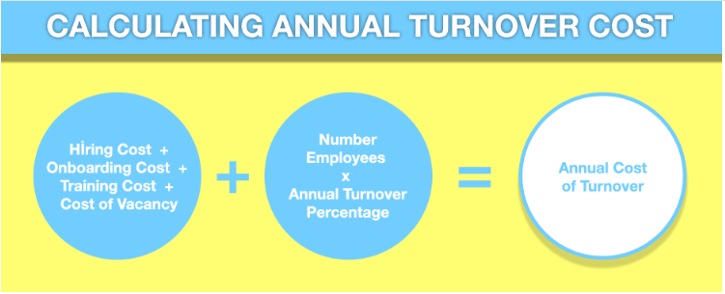
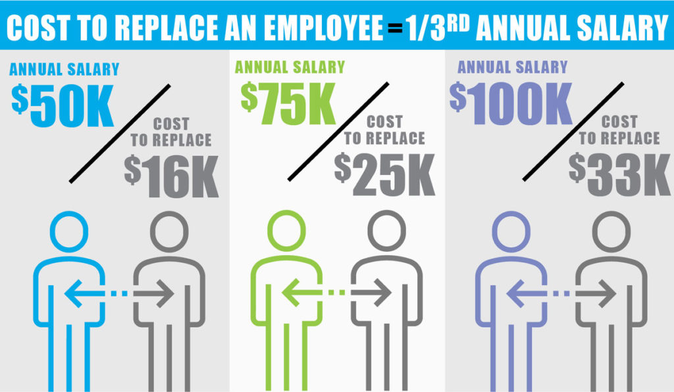
SHRM reports that on average it costs
one third of an employee’s annual salary
salary to replace them
According to Harvard Business Review,
80% of employe turnover is due to
poor recruitment decisions
Costs Associated with Turnover:
Exit costs
Recruiting
Interviewing
Hiring
Orientation
Training
Lost productivity
Customer dissatisfaction
Reduced or lost business
Administrative costs
Lost expertise
Temporary workers

Slide 5

Turnover Good or Bad?
Employee turnover is often viewed as a negative thing, but not all turnover is bad. Healthy turnover is when employees leave to pursue better career opportunities or to explore new challenges. Good turnover can also include the departure of toxic employees, bottom performers, and other employees who may be causing issues in the workplace.
Benefits of Healthy Turnover …
Internal career growth
Employees pursuing new opportunities better suited to their skills and interests
Improved management
Increased productivity
Improved morale
Improved engagement
Improved innovation
Improved team cohesion
Lowered legal risks
Increased salary savings
Increased stability

Slide 6

Combatting Unhealthy Turnover
While some turnover can be healthy for an organization, unhealthy turnover can be detrimental to both morale and the bottom line. Unhealthy turnover occurs when top performers leave because of job dissatisfaction or lack of growth opportunities and are not replaced by similarly skilled employees. This can result in a talent drain, decreased productivity, and increased costs of replacement.
Signs of unhealthy turnover ...
High levels of employee absenteeism
Low employee engagement and satisfaction
Frequent exits from critical roles
When talented employees leave in droves, it can also damage the company's reputation and make it difficult to attract new hires. By creating a supportive work environment and fostering a culture of growth and development, organizations can reduce unhealthy turnover and retain top talent for the long-term.

Slide 7
Essentials for Retaining Top Talent & Building High Performing Teams
Competitive Compensation & Total Rewards Package
Professional Development Opportunities
Recognition & Rewards
Work-Life Balance
Employee Engagement Initiatives
Flexible Work Arrangements
Effective Leadership
Communication
Create a Positive Work Culture
Hire the Right People!
Clear Career Paths
Employee Well-Being Programs

Slide 8


Recruiting Top Talent …
Create a Positive Workplace Culture
Develop Effective Job Descriptions
Prioritize Critical Criteria
Understand Your Employee Value Proposition (EVP)
Hire for Culture ADD Not Culture Fit
Do Your Own Networking
Know your Best Sources for Talent
Treat your Candidates like Customers!
Create a GREAT Candidate Experience
Remember that First Impressions Matter!
Keep it Two-Way …
Have an Actual Conversation!
Stay in Contact with Quality Candidates
Act QUICKLY to Interview & Extend Offers to Top Talent
Make the most of social media
Build your employer brand
Boost diversity and inclusion

Slide 9
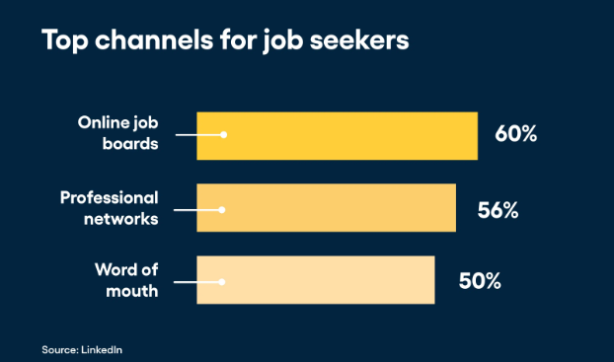
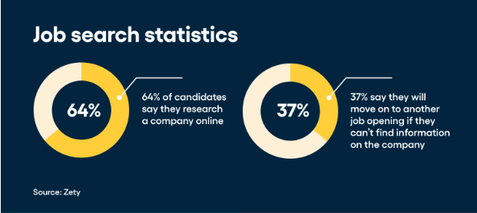
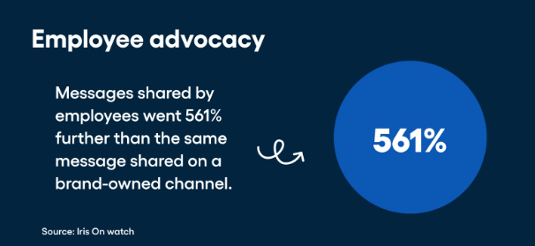
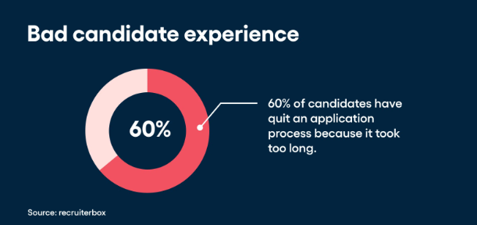

Slide 10

Benefits of Making Good Hiring Decisions …
Improved performance
Good hires are more productive and engaged, which can lead to better overall workplace performance. Top talent can be up to eight times more productive than average.
Positive company culture
Good hires can help create a positive and productive culture within an organization.
Improved retention
Employees who feel like they fit in with their team are more likely to stay with the organization long-term.
An effective recruitment and selection process can help reduce attrition.
An effective recruitment and selection process can improve a company's bottom line.

Slide 11


Be proactive … take intentional steps to attract & retain top talent and make good hiring decision.
Understand the reasons employees leave jobs and that not all turnover is bad.
Encourage “ healthy” turnover .
Recognize “unhealthy” turnover and take measures to address it.
Create a positive work environment where employees feel valued, safe and included and where their feedback is encouraged and heard.
Remember that word of mouth is a major source of advertising and it’s also the cheapest!

Slide 12


